Slide 1

Automated Medical Podcast Transcription and Topic Segmentation
An AI & NLP Based System For Medical Audio Analysis
Presented By:
Ch . Parimala Jyothika

Slide 2

Introduction
Medical podcasts have emerged as an important source of clinical and educational information for medical students, healthcare professionals, researchers, and educators. These podcasts cover a wide range of topics such as diseases, symptoms, treatment methods, clinical case discussions, and public health awareness.
Experts often share real-world medical experiences and updated clinical practices, making podcasts a valuable supplementary learning resource alongside textbooks and journals. However, most medical podcasts are lengthy and unstructured, requiring listeners to spend significant time to locate specific information.
This creates a strong need for an intelligent system that can automatically convert medical podcast audio into structured, searchable, and easily accessible content.

Slide 3

Problem Statement
Medical podcasts contain highly valuable clinical and educational information, but their long duration and lack of structure make them difficult to analyze and navigate. Listeners often need to spend a significant amount of time searching for specific disease discussions, treatment explanations, or clinical insights within a single podcast episode.
Since podcasts are audio-based, traditional text-based search and indexing methods cannot be applied directly. As a result, users are forced to manually listen to entire episodes, which is inefficient and time-consuming. This highlights the need for an automated system that can convert medical podcast audio into structured, searchable, and topic-wise organized content.

Slide 4
Objectives of the Project
The primary objective of this project is to develop an AI-driven system that improves the accessibility and usability of medical podcast content. The system aims to accurately convert medical podcast audio into text and organize the information in a structured and meaningful manner.
The specific objectives of the project are:
To automatically transcribe medical podcast audio using advanced speech-to-text models
To segment long podcast transcripts into meaningful topic-based sections
To extract important medical keywords that summarize each topic
To perform sentiment analysis in a medical-aware context
To evaluate transcription quality using standard performance metrics
To provide an interactive user interface for easy navigation and analysis

Slide 5
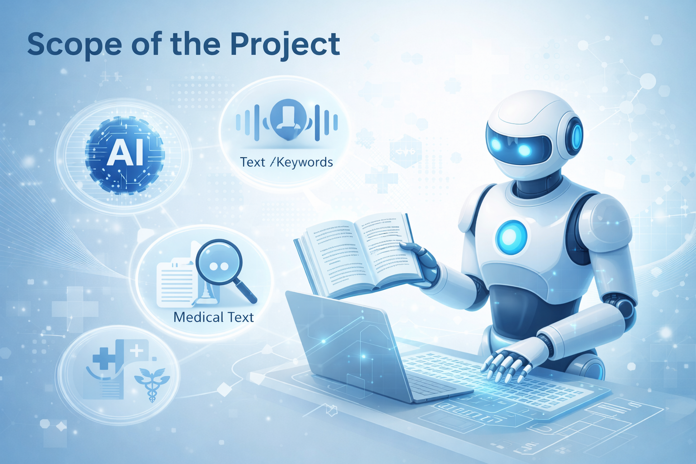
Scope of the Project
Automated analysis of recorded medical podcast audio
Uses AI & NLP techniques
Audio preprocessing and speech-to-text transcription
Topic segmentation and keyword extraction
Sentiment analysis and transcription quality evaluation
Web-based interface for visualization and analysis
Supports pre-recorded audio only
Intended for educational and informational purposes

Slide 6

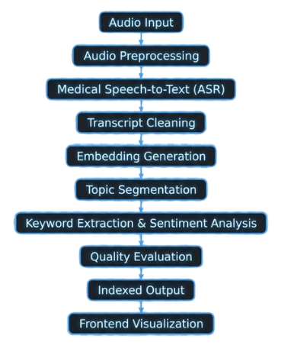
System Architecture

Slide 7
Core Application Modules
Audio Preprocessing:
Converts raw podcast audio into a standard format
Removes background noise and silent segments
Ensures consistent audio quality
2. Speech-to-Text Transcription:
Converts medical podcast audio into text
Handles medical terminology accurately
Generates time-aligned transcripts
3. Topic Segmentation:
Divides long transcripts into meaningful topics
Detects topic boundaries using semantic similarity
Improves navigation within podcast

Slide 8

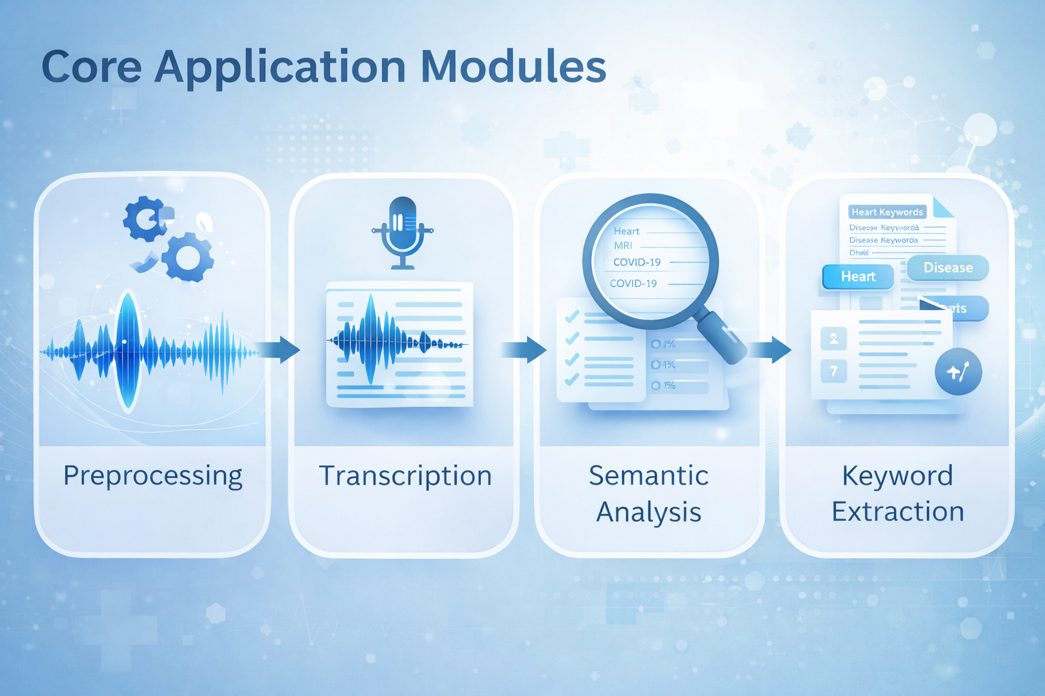
4. Keyword Extraction
Identifies important medical terms per topic
Helps summarize and index content
Supports quick understanding
5. Sentiment & Quality Analysis
Analyzes emotional tone of medical discussions
Evaluates transcription accuracy (WER, CER)
Ensures reliability of generated text
6. Frontend Visualization
Displays transcripts and topic segments
Shows keywords, sentiment, and metrics
Enables user-friendly interaction

Slide 9

Frontend Interface
1
Web-based interactive interface
2
Medical podcast audio upload
3
Transcript and topic-wise content view
4
Medical keyword highlighting
5
Sentiment & transcription quality metrics(WER,CER)
6
Time-stamp based audio navigation

Slide 10

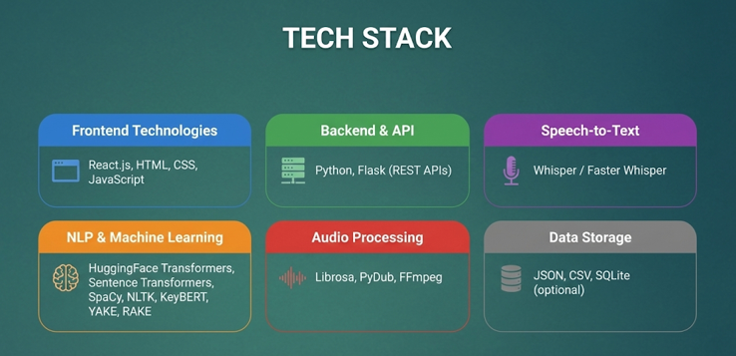
Technology Stack

Slide 11

Challenges Faced
Handling complex medical terminology accurately
Managing background noise in podcast audio
Detecting correct topic boundaries in long conversations
Avoiding incorrect sentiment classification for clinical content
Maintaining transcription accuracy across different speakers

Slide 12
🎙️
Speaker Diarization
🌍 Multilingual Transcription
🧬 Medical NER
📝 Auto Summarization
🔎
Semantic Search
Future Scope

Slide 13


Conclusion
🎧 Automates medical
podcast transcription
and analysis
🔎 Transforms unstructured
audio into structured, searchable content
⏱️ Saves time for medical students and healthcare professionals
🤖 Demonstrates effective use of AI & NLP techniques
in healthcare

Slide 14
THANK YOU

